Slide 1
Intellectual Property and Open Source
Prof. Dr. Dirk Riehle
Friedrich-Alexander University Erlangen-Nürnberg
FOSS B02
Licensed under CC BY 4.0 International
Notes:
It is Friedrich-Alexander University Erlangen-Nürnberg – FAU, in short.
Corporate identity wants us to say “Friedrich-Alexander University”.

Slide 2
Open Source and Innovation
Legal innovation
Process innovation
Software tool innovation
Business model innovation

Slide 3
Intellectual Property (IP)
Property
  Is some tangible or intangible entity
  Has an owner who has legal title to the property
Intellectual property is property that is
  Conceptual, i.e. non-tangible and usually non-fungible
  Unique, i.e. not-a-commodity, not-interchangeable
Intellectual property rights are exclusion rights
  The owner has the right to exclude others from use

Slide 4
Three Types of Intellectual Property
Copyright
Patent rights
Trademark rights

Slide 5
Copyright
Copyright is a right to intellectual property
  For a specific expression, initially given to creator of work
  To exclude anyone from presentation, reproduction, modification
  It will eventually expire and the work will enter the public domain
Copyright law varies by jurisdiction
  Under U.S. law, can be signed over to third person
  Under German law (Urheberrecht) only usage rights can be granted
  Interpretation of one law in another jurisdiction is questionable
In software, examples of works that can be copyrighted are
  User interface designs
  Source code

Slide 6
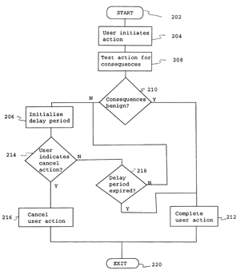

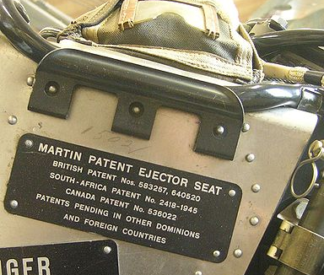
Patent Rights
A patent right is a right to intellectual property
  For a non-obvious industrial invention
  To exclude anyone from using the invention
  It will eventually expire; invention will enter the public domain
Patent right goal is foster innovation by motivating disclosure

Slide 7




Trademark Rights
Trademark rights are a right to intellectual property
  For a distinctive textual or visual sign, smell, sound
  To exclude anyone from using the sign, smell, sound
  They never expire, if registered and enforced (“use it or lose it”)

Slide 8
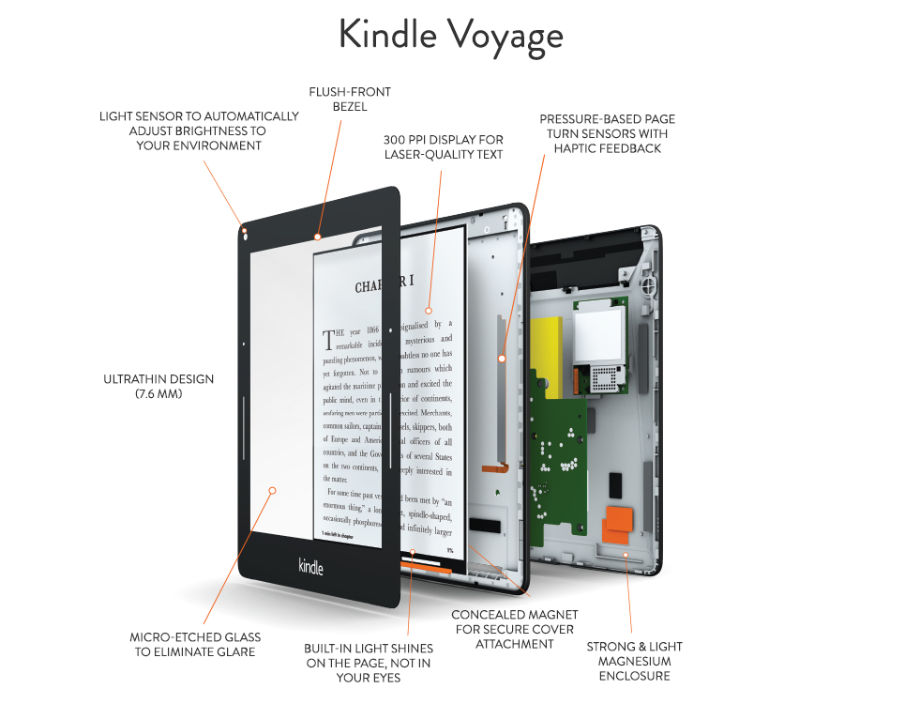
Quiz: Identify the Intellectual Property

Slide 9
Exclusion Rights in Comparison
 | Copyright | Patents | Trademarks
Form | Text, other specific expressions of non-trivial complexity | Abstract idea that represents a non-trivial industrial invention | Equivalence set of uniquely identifiable expressions
Purpose | To promote otherwise unprotectable artistic expression by protecting it | To spur innovation by motivating the disclosure of trade secrets | To protect consumers from confusion by providing unique marks
Duration | Will eventually expire, but only after several decades | Will eventually expire, but only after a few decades (shorter than copyright) | Will not expire as long as it is enforced by trademark owner
Granting | Automatic by creation | By application to patent office | By application to trademark authority

Slide 10
License
A license is a contract (rights grant) (in most jurisdictions)
  Between a licensor and a licensee to
    Reproduce, adapt, modify, translate, publish, publicly perform or display, distribute
    Some tangible or intangible property
  Is only valid if the licensor can actually grant these rights
The rights grant can be
  Perpetual, irrevocable, worldwide, royalty-free, exclusive
The most common license type is the EULA
  EULA = End-user License Agreement

Slide 11
Quiz: Common License Terms
What are the opposites of these terms and what do they mean?
  Perpetual
  Irrevocable
  Worldwide
  Royalty-free
  Exclusive

Slide 12
Software License
A software license is a license about software
  Based on exclusion rights, a software license may provide permission to ...
    Use
    Reproduce
    Adapt
    Modify
    Translate
    Publish
    Publicly perform or display
    Distribute
Is typically based on copyright, trademarks and patents

Slide 13
Free / Libre and Open Source Licenses
An open source license is a software license
  That grants the rights to …
    Receive, display, perform, modify, and redistribute
  Some piece of software free of charge
Open source licenses are non-discriminatory
Early licenses focused on copyright, ignored patents
May come with obligations, not just rights
Are maintained by the FSF and OSI

Slide 14
The Four Freedoms of Free Software [F10]
The freedom to run the program as you wish, for any purpose (freedom 0).
The freedom to study how the program works, and change it so it does your computing as you wish (freedom 1). Access to the source code is a precondition for this.
The freedom to redistribute copies so you can help your neighbor (freedom 2).
The freedom to distribute copies of your modified versions to others (freedom 3). By doing this you can give the whole community a chance to benefit from your changes. Access to the source code is a precondition for this.

Slide 15
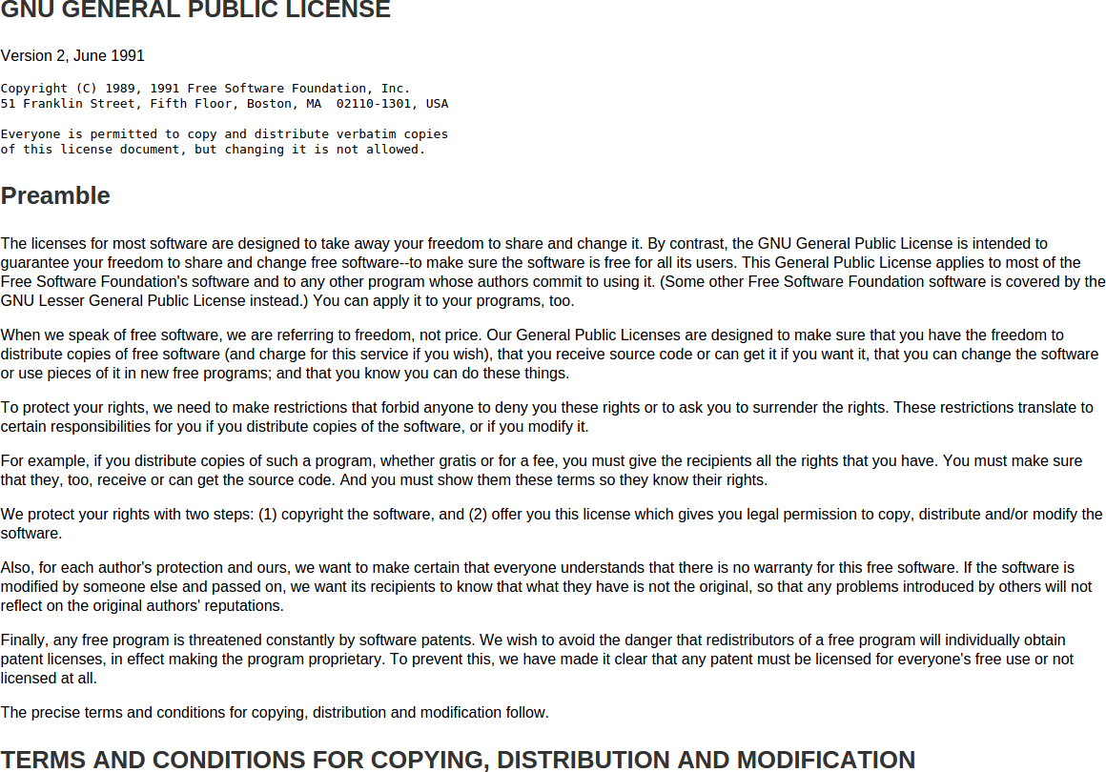

Slide 16
Copyleft (“Reciprocal”) License
Copyleft is a copyright-based strategy to ensure original rights cannot be curtailed when passed from licensor to licensee
The licensee of copyleft-licensed software will have to use the same copyleft license (or later) when passing on the software
C
V
U
Licensor
Licensor
Licensee
Licensee
original distribution
redistribution
C: Creator
V: Vendor
U: User

Slide 17
Quiz: Charging for Copyleft Code
Can you charge someone before you give them access to copyleft-licensed software?
  Yes
  No

Slide 18
Free as in Freedom, not as in Beer
/*
* ----------------------------------------------------------------------------
* "THE BEER-WARE LICENSE" (Revision 42):
* <phk@FreeBSD.ORG> wrote this file. As long as you retain this notice you
* can do whatever you want with this stuff. If we meet some day, and you think
* this stuff is worth it, you can buy me a beer in return Poul-Henning Kamp
* ----------------------------------------------------------------------------
*/

Slide 19
Open Source Software License 1 / 2 [O10]
1. Free Redistribution
The license shall not restrict any party from selling or giving away the software as a component of an aggregate software distribution containing programs from several different sources. The license shall not require a royalty or other fee for such sale.
2. Source Code
The program must include source code, and must allow distribution in source code as well as compiled form. Where some form of a product is not distributed with source code, there must be a well-publicized means of obtaining the source code for no more than a reasonable reproduction cost preferably, downloading via the Internet without charge. The source code must be the preferred form in which a programmer would modify the program. Deliberately obfuscated source code is not allowed. Intermediate forms such as the output of a preprocessor or translator are not allowed.
3. Derived Works
The license must allow modifications and derived works, and must allow them to be distributed under the same terms as the license of the original software.
4. Integrity of The Author's Source Code
The license may restrict source code from being distributed in modified form only if the license allows the distribution of "patch files" with the source code for the purpose of modifying the program at build time. The license must explicitly permit distribution of software built from modified source code. The license may require derived works to carry a different name or version number from the original software.
5. No Discrimination Against Persons or Groups
The license must not discriminate against any person or group of persons.

Slide 20
Open Source Software License 2 / 2
6. No Discrimination Against Fields of Endeavor
The license must not restrict anyone from making use of the program in a specific field of endeavor. For example, it may not restrict the program from being used in a business, or from being used for genetic research.
7. Distribution of License
The rights attached to the program must apply to all to whom the program is redistributed without the need for execution of an additional license by those parties.
8. License Must Not Be Specific to a Product
The rights attached to the program must not depend on the program's being part of a particular software distribution. If the program is extracted from that distribution and used or distributed within the terms of the program's license, all parties to whom the program is redistributed should have the same rights as those that are granted in conjunction with the original software distribution.
9. License Must Not Restrict Other Software
The license must not place restrictions on other software that is distributed along with the licensed software. For example, the license must not insist that all other programs distributed on the same medium must be open-source software.
10. License Must Be Technology-Neutral
No provision of the license may be predicated on any individual technology or style of interface.

Slide 21
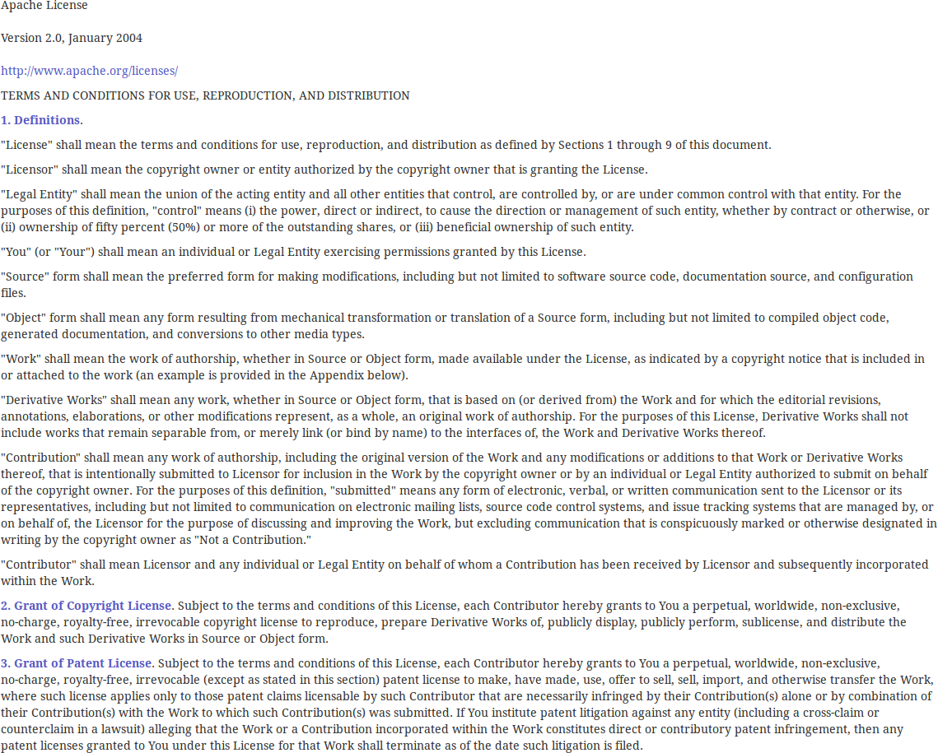
The Apache 2.0 License

Slide 22
How to License?
License File
File Header
More ...

Slide 23
Example License in File Header
/*
* Copyright (c) 200X-200X by Humpty Dumpty
*
* This file is part of the Humpty Dumpty application.
*
* This program is free software: you can redistribute it and/or modify
* it under the terms of the GNU Affero General Public License as
* published by the Free Software Foundation, either version 3 of the
* License, or (at your option) any later version.
*
* This program is distributed in the hope that it will be useful,
* but WITHOUT ANY WARRANTY; without even the implied warranty of
* MERCHANTABILITY or FITNESS FOR A PARTICULAR PURPOSE. See the
* GNU Affero General Public License for more details.
*
* You should have received a copy of the GNU Affero General Public
* License along with this program. If not, see
* <http://www.gnu.org/licenses/>.
*/
package com.firm.model;
...

Slide 24
How to be License Compliant?
Copyright notice
Disclaimer
More ...

Slide 25
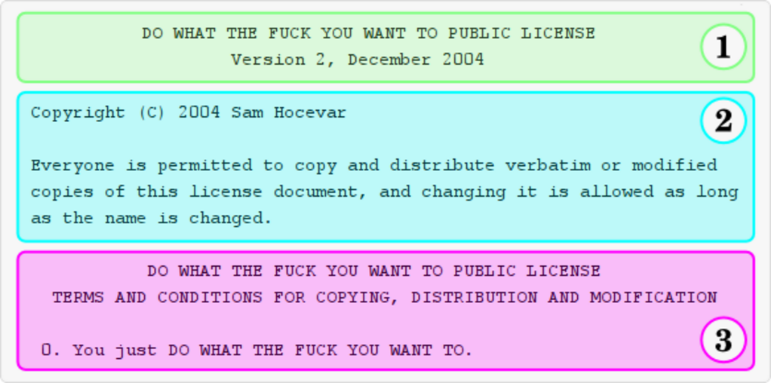
WTFPL [H04]

Slide 26
Freedom vs. Freedom
Copyleft freedom
  Freedom for the software, primarily
Permissive freedom
  Freedom for the developer, primarily

Slide 27
Collective vs. Derivative Work
In U.S. copyright law,
  A “collective work” is a work, such as a periodical issue, anthology, or encyclopedia, in which a number of contributions, constituting separate and independent works in themselves, are assembled into a collective whole.
  A “derivative work” is a work based upon one or more preexisting works, such as a translation, musical arrangement . . . art reproduction, abridgement, condensation, or any other form in which a work may be recast, transformed, or adapted. A work consisting of editorial revisions, annotations, elaborations, or other modifications which, as a whole, represent an original work of authorship, is a “derivative work.”
Copyleft effect only applicable to derivative, not collective works

Slide 28
Derivative, Combined, and Collective Work
Derivative work
Combined work
Collective work

Slide 29
Copyleft Effect and Derivative Work
Licensor perspective on copyleft effect
Freedom of code for receiver of redistribution
Licensee perspective on non-copyleft effect
Freedom of choice for licensor how to redistribute
Derivative work
Combined work
Collective work

Slide 30
Reciprocal vs. Permissive License
GNU Public License v2
  It permits
    Use of the software
  It requires
    Open sourcing of modifications upon redistribution
    Proper attribution
    Inclusion of license in distribution
  It forbids
    Claims of endorsement
    Use of FSF trademarks
Apache License 2.0
  It permits
    Use of the software
    Redistribution of modification without open sourcing
  It requires
    Proper attribution
    Inclusion of license in distribution
  It forbids
    Claims of endorsement
    Use of ASF trademarks

Slide 31
Critical License (Design) Issues
Triggers for having to open source
  Definition of collective vs. derivative work
  Definition of redistribution
Other obligations put on redistributions
  Display of attribution, copyright notice
  How to treat source code, provision of license files
Other considerations
  Provision of exceptions to standard license
  Also, jurisdiction matters, no single global legal system

Slide 32
Quiz: Collective or Derivative Work?
In a project, you use file X which is GPLv2 licensed
  You change file X to become X’
    Is file X’ a collective or derivative work?
  You create a class A in file Y which subclasses a class from file X
    Is file Y a collective or a derivative work?
  You create code in file Z which uses code from file X
    Is file Z a collective or a derivative work?
  You statically link file X and file Y into file A
    Is file A a collective or a derivate work?
  You dynamically link file Z with file X and deliver the files to your customer
    Is file Z a collective or a derivative work?
  You create file B, code of which makes a web service call to file X
    Is file B a collective or a derivative work?

Slide 33
Decoupling Components Using Shims
Proprietary
Code
Shim
Copyleft
Code

Slide 34
The GPL License Family
LGPLv1
LGPLv2
LGPLv3
library
GPLv1
GPLv2
GPLv3
Use Case
regular
–
–
AGPLv3
web
service
v1
v2
v3
Major Release

Slide 35
New in the GPLv3 License Family
Introduction of new use case “web service”
  Affero GPLv3 license considers use of web service licensing of software
Introduction of patent clauses, in particular patent retaliation
  An attempt to stem the tide of (mostly) non-sensical software patents
Increased compatibility with other open source licenses

Slide 36
Quiz: Licenses and Business Strategy
Google Code used to be a code hosting facility for open source projects. Initially, Google only allowed for a subset of licenses. Why?
  Too many licenses confuse users
  Some licenses are good for Google, some are not
  Some licenses were not possible to use for Google Code hosted projects

Slide 37
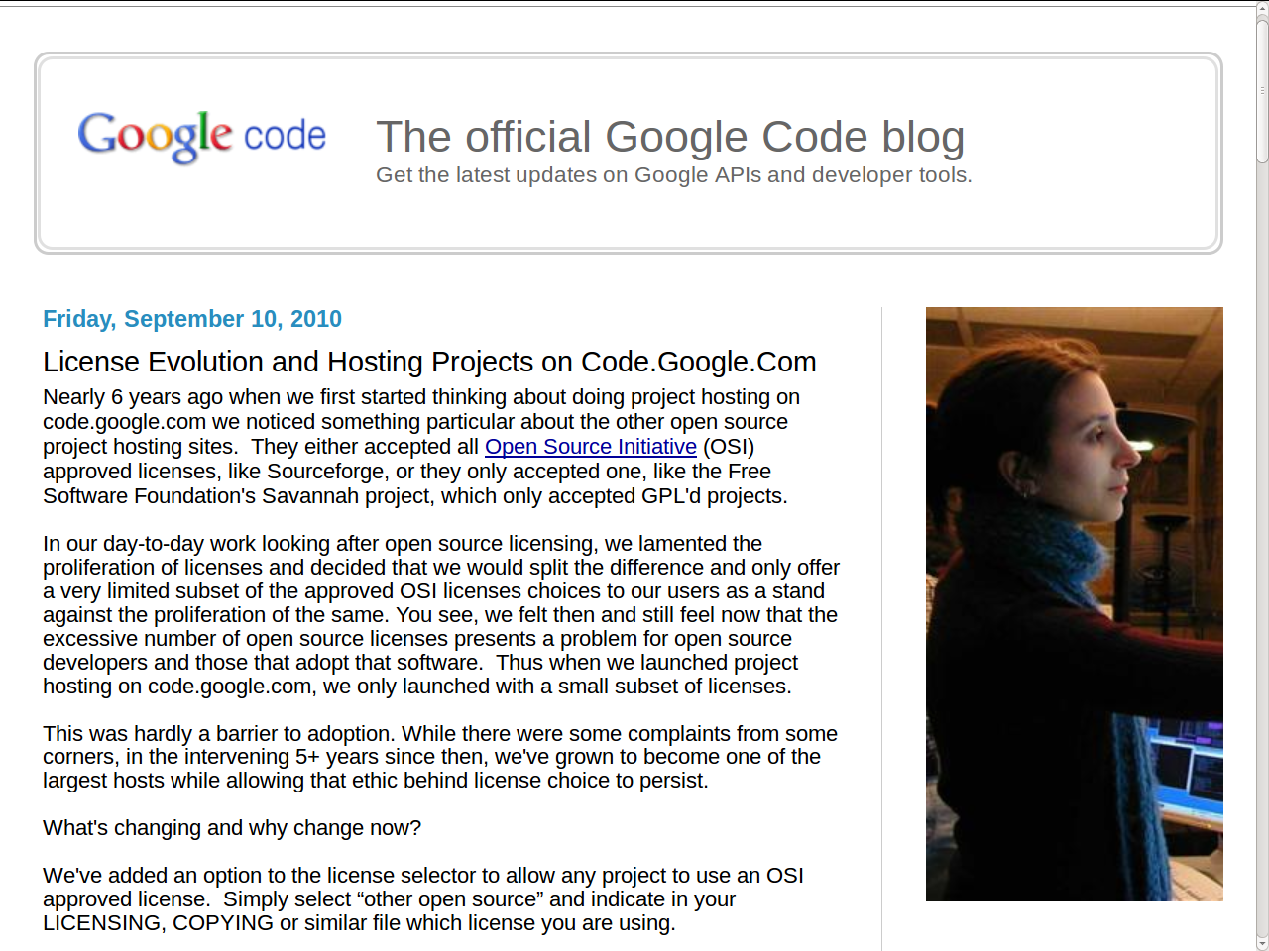

Slide 38
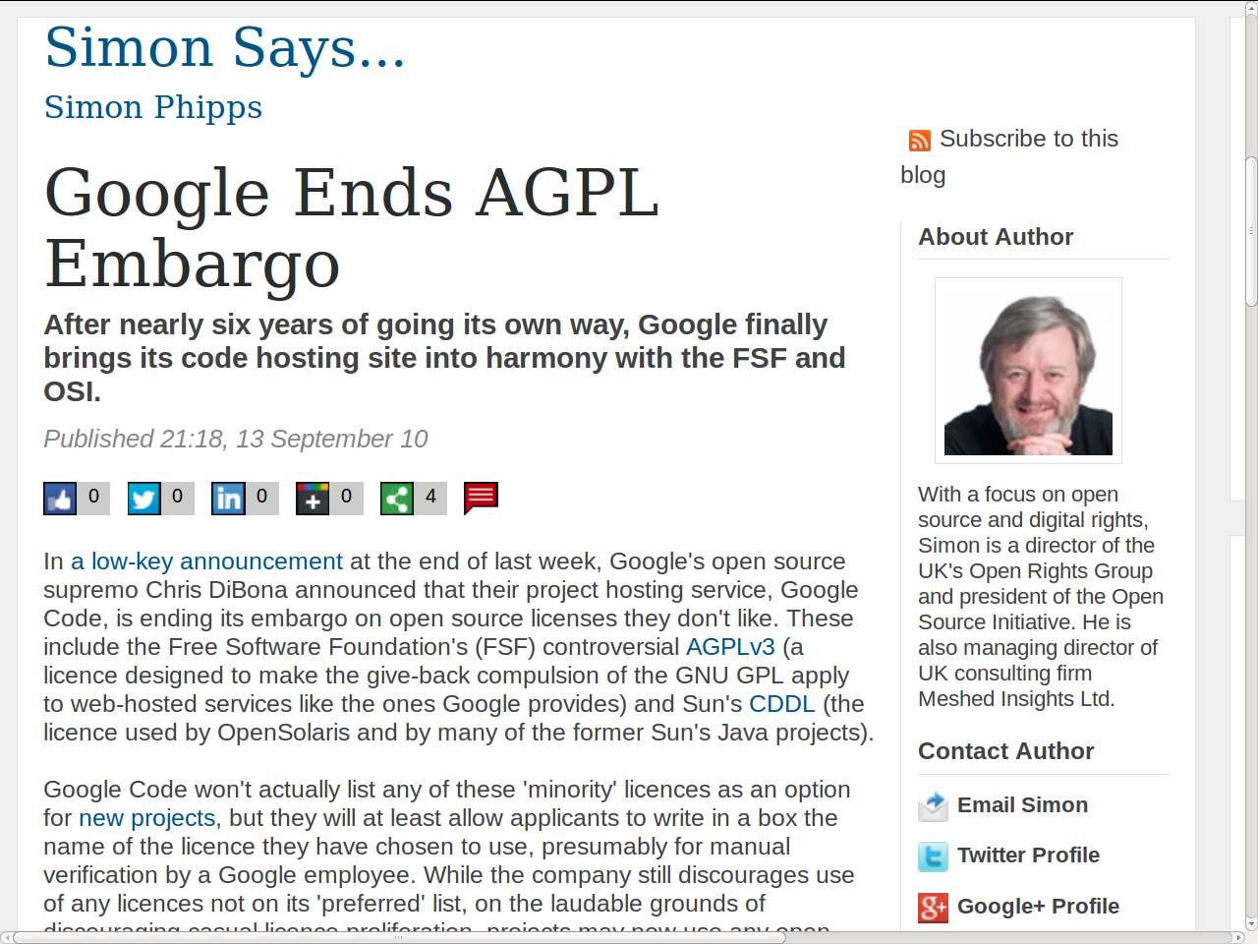

Slide 39
Patents and Open Source Licenses
Patent rights grant
  §3 of the Apache License 2.0:
    “Subject to the terms and conditions of this License, each Contributor hereby grants to You a perpetual, worldwide, non-exclusive, no-charge, royalty-free, irrevocable (except as stated in this section) patent license to make, have made, use, offer to sell, sell, import, and otherwise transfer the Work, where such license applies only to those patent claims licensable by such Contributor that are necessarily infringed by their Contribution(s) alone or by combination of their Contribution(s) with the Work to which such Contribution(s) was submitted.”
So-called patent retaliation clause
  §3 of the Apache License 2.0 continued:
    “If You institute patent litigation against any entity (including a cross-claim or counterclaim in a lawsuit) alleging that the Work or a Contribution incorporated within the Work constitutes direct or contributory patent infringement, then any patent licenses granted to You under this License for that Work shall terminate as of the date such litigation is filed.”

Slide 40
License Categories
Strong copyleft licenses
  Purpose: Free the software
  Try to apply copyleft as far as they can
  A.k.a. “reciprocal” or “protective”
Weak copyleft licenses
  Purpose: Benefit business models with limited restrictions
  Limit copyleft effect to modifications of work
  A.k.a. “reciprocal” or “protective”
Permissive licenses
  Purpose: Trust self-interest, no restriction of business models
  Do not apply copyleft effect

Slide 41
The State of Open Source Licenses
More than 50 approved active licenses
  Some licenses are general-purpose, some are product specific
  Licenses often have a matching “telling” name, e.g. MIT, zlib
  More than ten licenses have been retired
Common license properties
  No warranties given or implied (to the extent permittable by law)
  Almost all require attribution

Slide 42
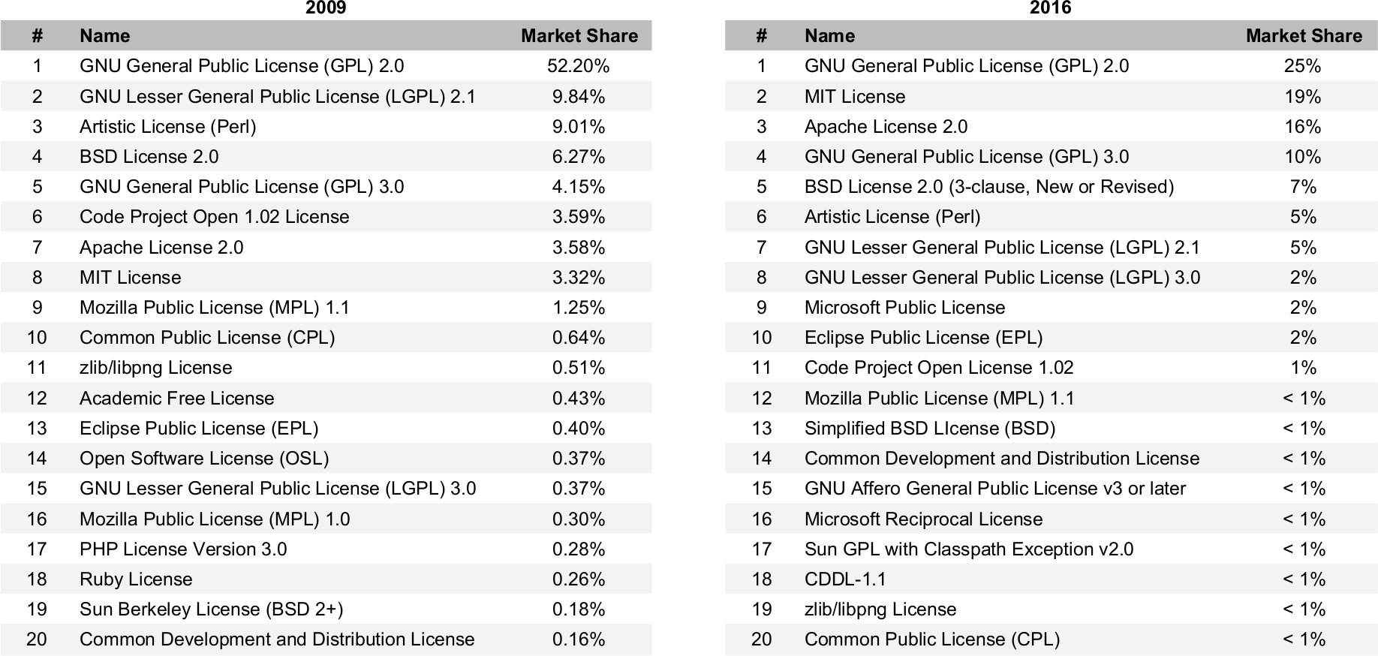
The Top 20 Licenses in 2009 [B09] and in 2016

Slide 43
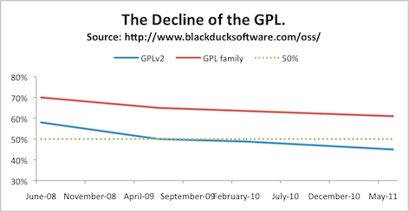
The Decline of the GPL [A11]

Slide 44
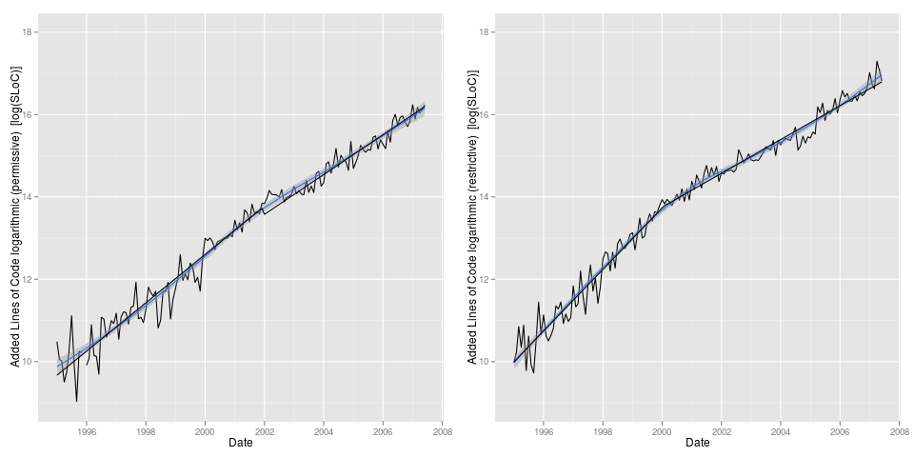
The Growth of Permissive Licenses [H+13]

Slide 45
Quiz: Provenance of Contributions
You are a developer. Please consider the following scenarios:
  On company-time, you make a contribution to the Linux kernel
  In your private time, you make a contribution to the Linux kernel [1]
  You adjust some code from the web and contribute it to the Linux kernel
  You implemented a new cryptography algorithm and contribute it
Who holds which rights and who has to sign off on what?
[1] This is a hypothetical. In practice, it is difficult to contribute to the Linux kernel, see lecture on open source software engineering.

Slide 46
Contributor License Agreement
A contributor license agreement
  Is a contract that legally clarifies any contributions you make to a project
  Needs to be signed by the owner of the rights (company or developer)
At least two variants of the contributor agreement
  Copyright transfer: The developer transfers all relevant rights
  Relicensing rights grant: The developer grants relicensing rights
The (stalled) Harmony project tried to unify these agreements
  Apparently, unification of contributor agreements wasn’t that important
  Some argue that the open source license is enough

Slide 47
Developer Certificate of Origin [T08]
Developer's Certificate of Origin 1.1
By making a contribution to this project, I certify that:
(a) The contribution was created in whole or in part by me and I have the right to submit it under the open source license indicated in the file; or
(b) The contribution is based upon previous work that, to the best of my knowledge, is covered under an appropriate open source license and I have the right under that license to submit that work with modifications, whether created in whole or in part by me, under the same open source license (unless I am permitted to submit under a different license), as indicated in the file; or
(c) The contribution was provided directly to me by some other person who certified (a), (b) or (c) and I have not modified it.
(d) I understand and agree that this project and the contribution are public and that a record of the contribution (including all personal information I submit with it, including my sign-off) is maintained indefinitely and may be redistributed consistent with this project or the open source license(s) involved.
Signed-off-by: Random J Developer <random@developer.example.org>
[lucky@maintainer.example.org: struct foo moved from foo.c to foo.h]
Signed-off-by: Lucky K Maintainer <lucky@maintainer.example.org>

Slide 48
License Evolution
Licenses often evolve over several versions (GPLv1, v2, v3, …)
  Licenses often allow for their replacement by a later version
  This allows the copyright holder of the license to fix problems
This allowed Wikipedia to move from the GFDL to CC-BY-SA
  The FSF and CreativeCommons created special licenses for Wikipedia
  By evolving through these “later” licenses, Wikipedia switched to CC

Slide 49
Dual and Multiple Licensing
Some software source code has multiple licenses
Users can choose the license they like best for their purposes
Dual-licensed software can act as a shim between two components

Slide 50
Example Package Structure
Affero GNU Public License v3
Like GNU Public License v3
Plus SaaS = redistribution
Wahlzeit
Jetty
PostgreSQL
OpenJDK
Apache 2.0 License
Copyright license [1]
Patent license [1]
Provide license, notice
Provide attribution
PostgreSQL License
Not reciprocal wrt source
Requires copyright display
No implied endorsement
GNU Public License v2
Reciprocal: Provide source
With Class Path Exception
Java linking = collective work
[1] Perpetual, worldwide, non-exclusive, royalty-free, irrevocable

Slide 51
The License Compatibility Circus [W09]
No License
Permissive
Weak Copyleft
Copyleft
Public
Domain
MIT / X11
LGPLv2.1
GPLv2
New BSD
LGPLv2.1+
GPLv2+
Apache 2.0
LGPLv3 (+)
GPLv3 (+)
Mozilla 1.1
Affero
GPLv3 (+)

Slide 52
Review / Summary of Session
Intellectual property
  Intellectual property rights
    Copyright, patents, trademarks
Open source licenses
  Copyleft vs. permissive licenses
    Historic and current use
  Derivative vs. combined work
  Licensing as a business strategy
  License compatibility
Intellectual property management

Slide 53
Thank you! Questions?
dirk.riehle@fau.de – http://osr.cs.fau.de
dirk@riehle.org – http://dirkriehle.com – @dirkriehle
DR

Slide 54
Credits and License
Original version
  © 2012-2019 Dirk Riehle, some rights reserved
  Licensed under Creative Commons Attribution 4.0 International License
Contributions
  ...

